Slide 1
Video Game Database Project

Slide 2
Scope
Semester long
Group of four
Three phases
Each phase building on the prior phase
Phase 1: Generate the conceptual model of the database
Phase 2: Generate and load data into the database
Phase 3: Perform data analysis on your database

Slide 3
Requirements
Multiple users can be managed by the application system
User data includes username, password, email, friends, etc.
Game data includes title, genre, platform, price, developers, etc.
Users must be able to perform actions with the games
  Record when a game is played and for how long
  Rate games from 1-5
  Create lists of games
Essentially a stripped-down version of Steam

Slide 4
Additional Requirements
Weekly discussions with customers
Video presentations after each phase
Updated report after each phase
The report included…

Slide 5
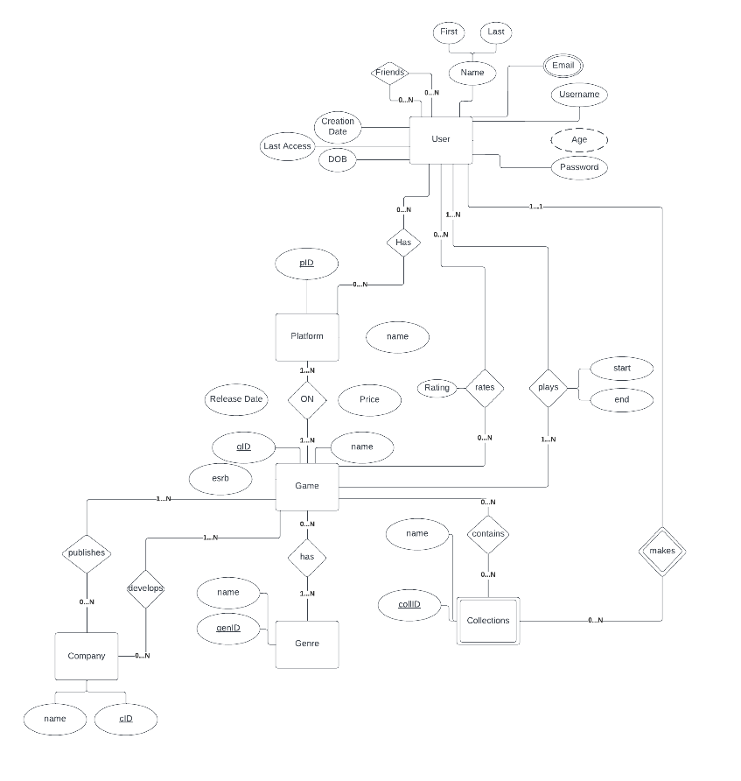
Entity-Relationship Model

Slide 6
Reduction to Tables
user(username, password, firstname, lastname, creation_date, last_access_date, DOB)
platform(platformID, name)
collections(collectionID, username, name)
genre(genID, name)
company(cID, name)
game(gID, name, esrb)
emails(username, email)
friends(friendUsername, frienderUsername)
hasPlatform(username, platformID)
gameOnPlatform(platformID, gID, releaseDate, price)
containsGame(collID,gID,username)
userRates(username, gID, stars)
userPlays(username, gID, start, end)
hasGenre(genID, gID)
publishes(cID, gID)
develops(cID, gID)

Slide 7
Sample User Table
username | password | firstname | lastname | creationDate | lastAccessDate | DOB
johndoe123 | hash(pass123) | John | Doe | 2023-01-01 | 2023-10-01 | 1990-07-09
janedoe456 | hash(iluvcats) | Jane | Doe | 2023-02-01 | 2023-10-03 | 1995-09-03
bobsmith789 | hash(123abc) | Bob | Smith | 2023-02-10 | 2023-10-04 | 1985-02-12
maryjane123 | hash(pass456) | Mary | Jane | 2023-02-14 | 2023-10-19 | 2002-12-25
samlee321 | hash(pass789) | Sam | Lee | 2023-02-20 | 2023-10-18 | 2000-06-02

Slide 8
Report
The report also included:
  SQL commands for creating the tables
  Commands for filling the tables
  Sample SQL commands for user requests including create account, search games, play game, etc.
  Data analytics
  Conclusions

Slide 9
Implementation
Utilized our reduction to tables to create the database
Used Oracle’s database
Filled with data from mockaroo
To manipulate the data as a user, there is a console application run with python
The user can do everything they’d want to log and track their video games

Slide 10
My Role
No explicit role assignments
Had to take a leadership role
Originally, had different goals than my groupmates

Slide 11
Teamwork Challenges
A day after teams were formed, a student dropped the class
Another student did not show up to team meetings during the first phase
  Helped him organize his time better
  Found more enjoyment helping us in second phase

Slide 12
Motivational Challenges
At the start, team members had different ideas of what constituted acceptable
Team members would try to take the easy way out, which would lead to more problems down the road

Slide 13
Learning as We Went
The project took place throughout the class, where we were learning how to do the project
Learned ER diagrams as we made them
Complicated SQL statements could be a struggle early on
We were taught data processing during final phase

Slide 14
Fixing Data
Before data analytics we looked at the data
Many of the user_plays data had end times before the start times
Others had unlikely playtime lengths ranging up to a year
Decided to replace with an average playtime or delete completely

Slide 15
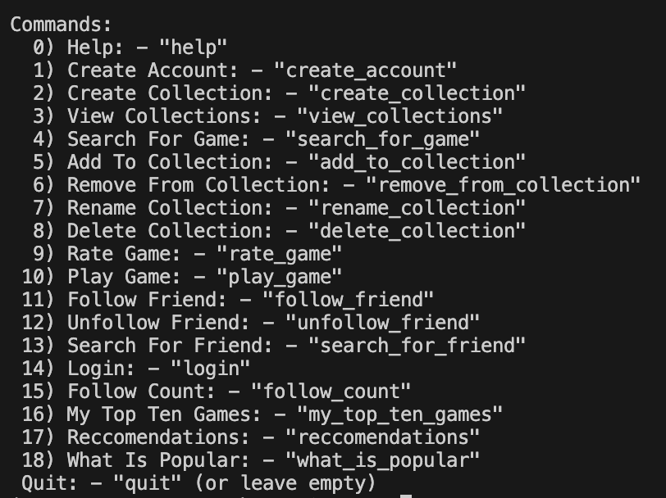
Outcomes
All possible functions:

Slide 16
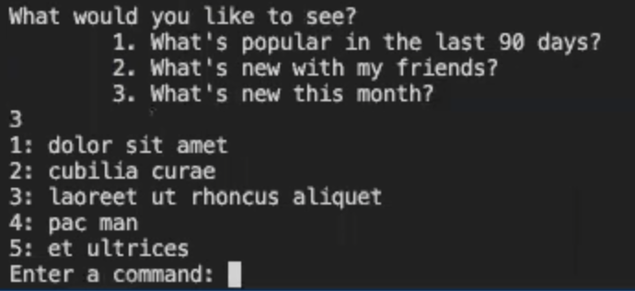
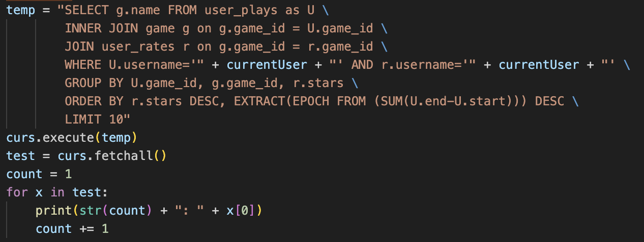
Example Command
Front End
Back End

Slide 17
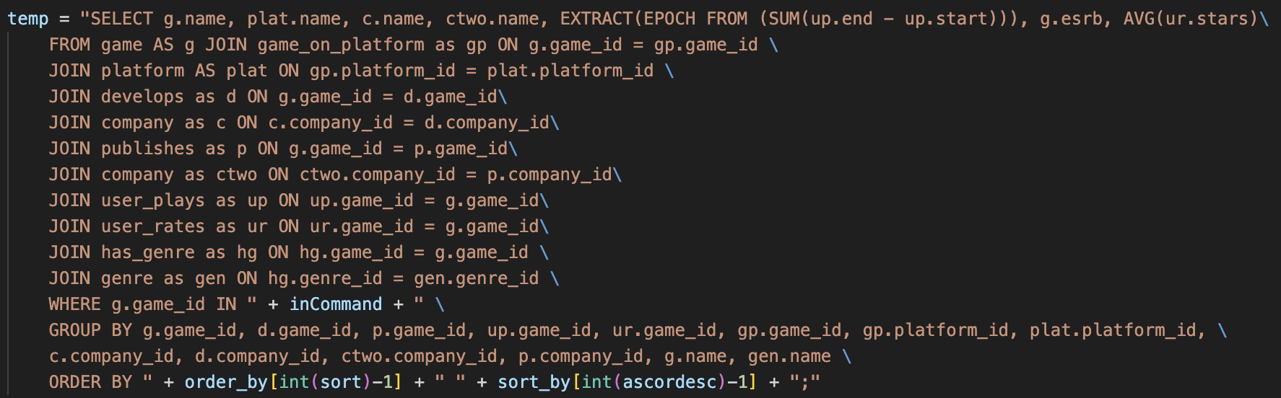
My Contributions
Loaded the database which contained 16 tables ranging from 1,000 to 30,000 entries
Dealt with writing the SQL statements, while others put them into the python app
Most difficult was searching by game name, when joins were a new concept:

Slide 18
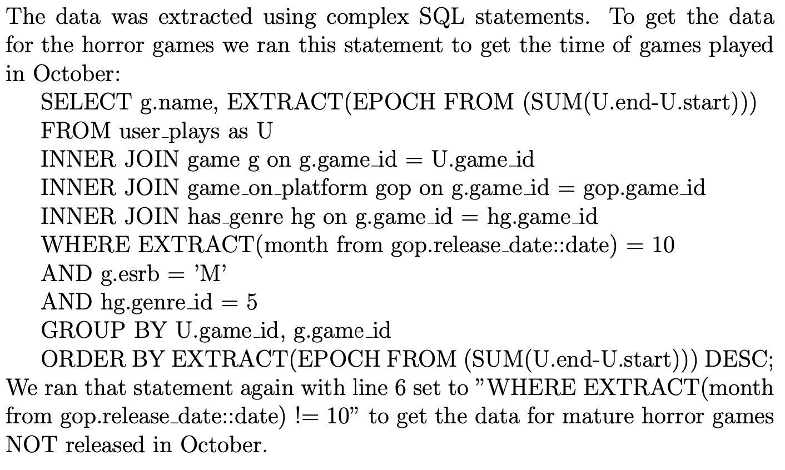
My Contributions
SQL statements and Excel sheets for analytics
Our hypothesis was that “mature horror games released in October will have higher total play times than mature horror games released in other months”

Slide 20
My Contributions
Encouraged teammates to stay after class to finish before due dates
Communicated weekly with professors to ensure standards were met
Recorded videos for professors so they could see current progress

Slide 21
Lessons Learned
Automate whenever possible
  Wrote a script to automatically hash every password
  Wrote scripts to fix broken data
  Wrote scripts for LaTeX tables for report

Slide 22
Lessons Learned
Play to strengths
  Student who was flaky early on was excellent with python
  Gave one of the recommendation features to the student who had just learned about recommendation trees
  Team members did what we enjoyed, even if we were not completely comfortable

Slide 23
Next Time
Ask more questions
  My professors knew more than me
  Believed that asking them for help diminished my achievement
  Asking for help would have made my project better and easier

